Slide 1
Fast Object Detection from Point Clouds for Autonomous Driving
T1: 陳奕達 戴妤珊 蔡岳峰
Advisor: Prof. Lai-Jiin
Date: 2022/12/29

Slide 2
Outline
Background
Model
Executing on GPU
Executing with Vitis AI
Executing with FINN
Comparison
Conclusion

Slide 3
Background

Slide 4
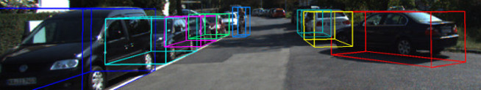
Background
Why object detection in autonomous driving
Vehicle detection
Pedestrian detection
Cyclist detection
LiDAR (3D point cloud) vs Cameras
More detail and accurate distances
More complex data to be processed

Slide 5
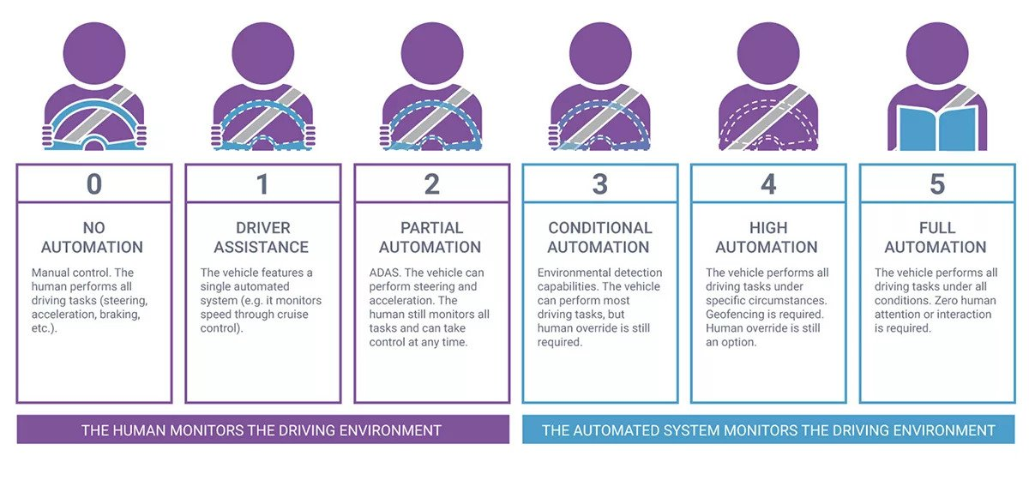
Motivation of Accelerating Object Detection in Autonomous Driving
In autonomous driving, the system requires continuing monitoring the driving environment.
Real time processing is required
Latency
Throughput

Slide 6
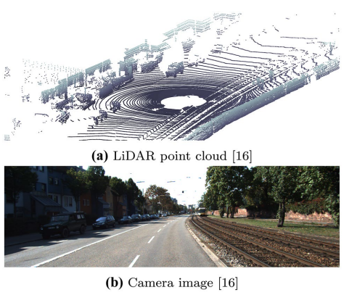
Dataset – KITTI Vision Benchmark Suite [1]
Provided data (#: 7481)
Point clouds from the LiDAR sensor
Images from four cameras (two monochrome and two color)
Information from the GPS/IMU navigation system

Slide 7
Model

Slide 8
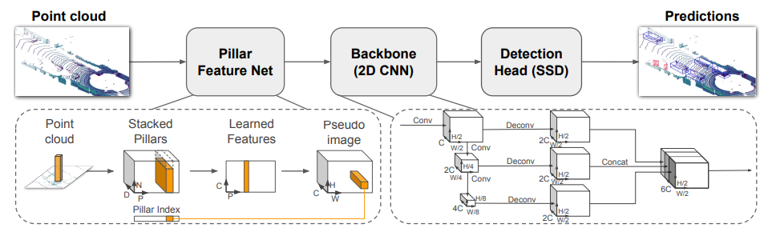
Target Model: PointPillars [2]
Modules
Pillar Feature Network (PFN): convert point cloud to a pseudo-image
Backbone: PointNet
SSD Detection Head
Lower complexity: 2D conv vs 3D conv

Slide 9
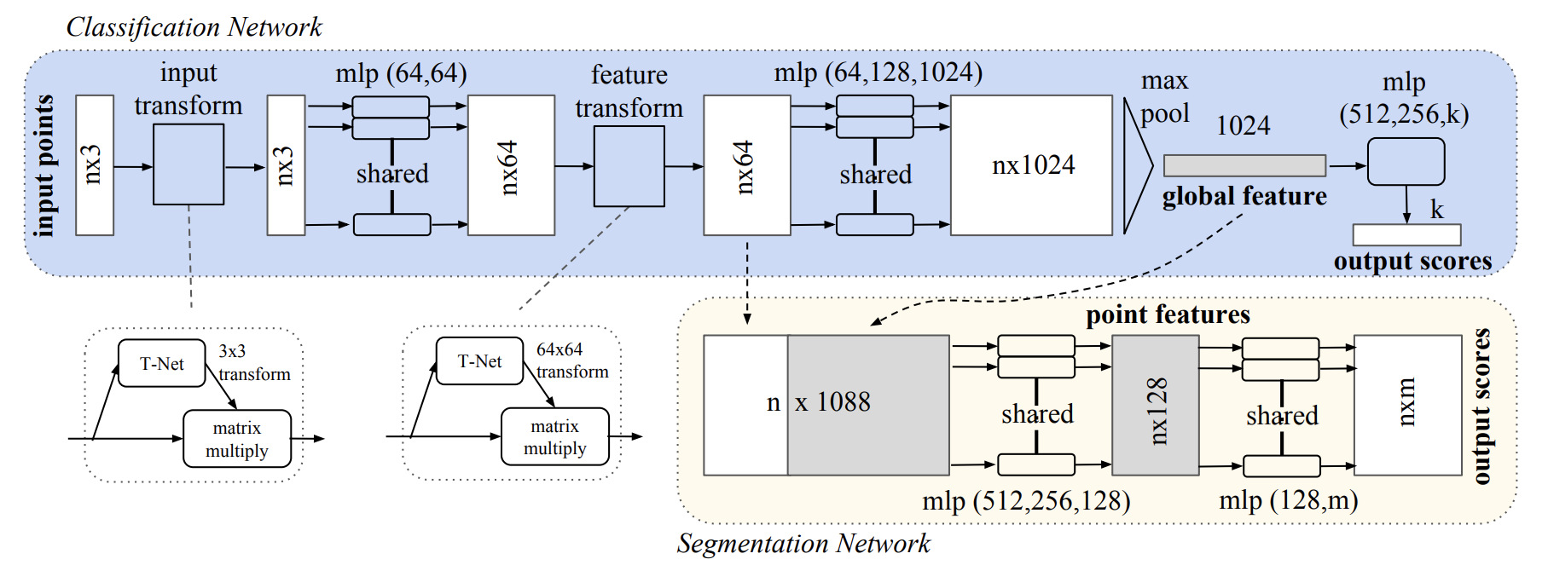
Backbone: PointNet _{CVPR’ 17}
Point cloud classification
Mainly compose of CNN and MLP

Slide 10
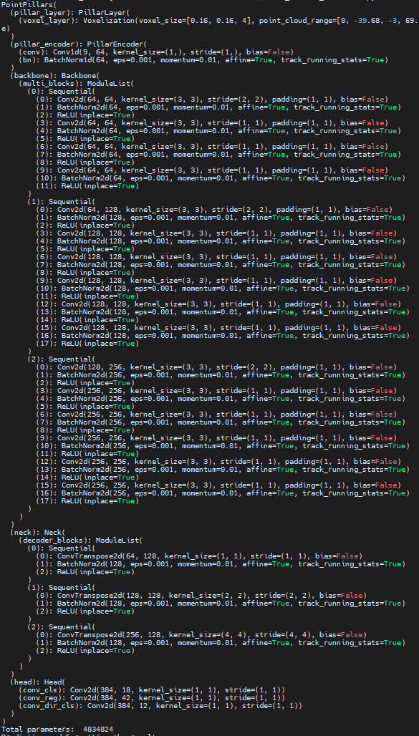
Model in PyTorch

Slide 11
Executing on GPU

Slide 12
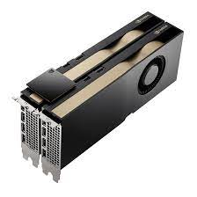
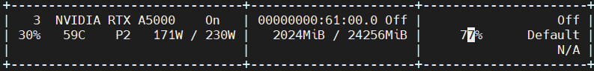
PointPillars on GPU
NVIDIA RTX A5000
 | NVIDIA RTX A5000
Energy consumption (W) | 171
Frames per second | 54.45

Slide 13
Executing with vitis AI

Slide 14
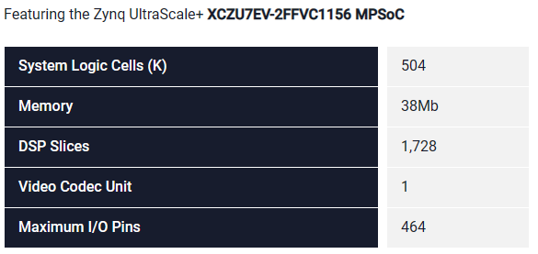
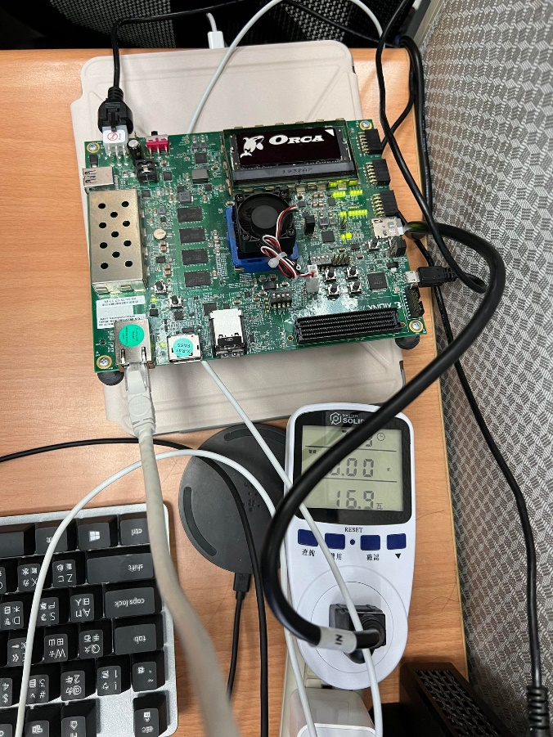
Measuring Environment
ZCU104
PYNQ: 85K logic, 220 DSP
KV260: 256K logic, 1.2K DSP
OS
PetaLinux
Power meter
Measure total power of ZCU104 for calculating power efficiency

Slide 15
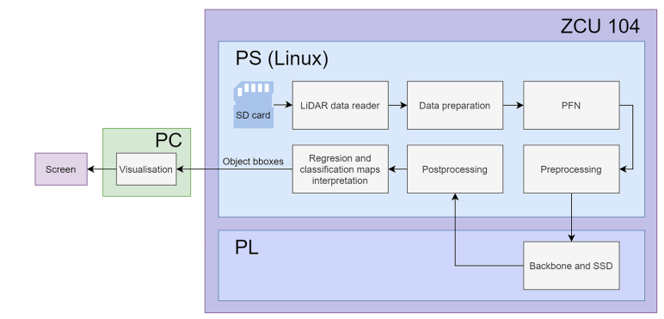
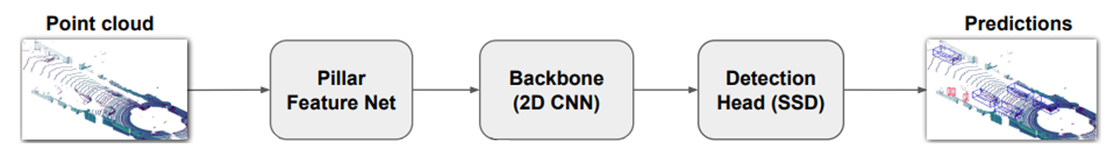
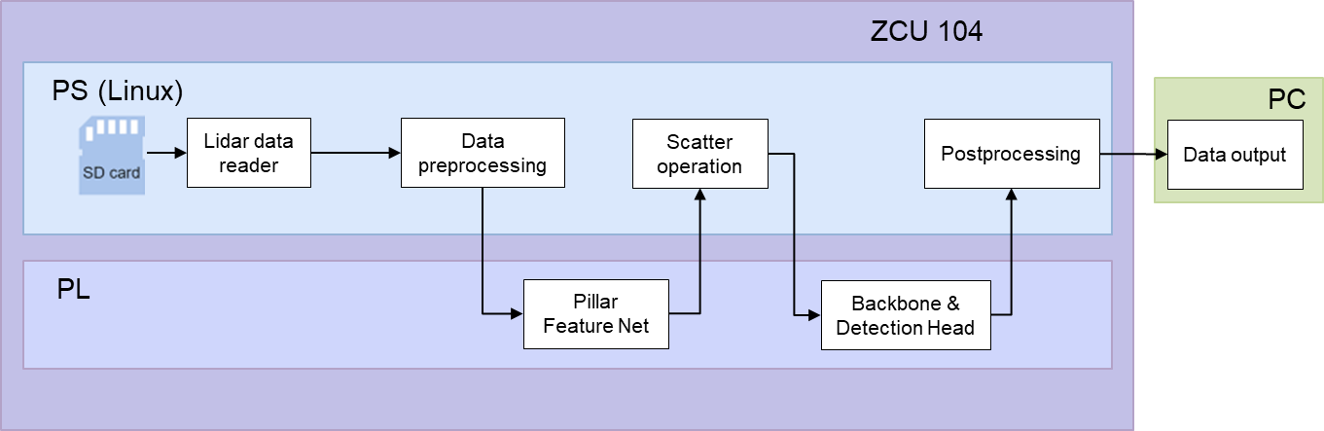
Vitis-AI: PointPillars Overview
ZCU 104
PS (Linux)
PC
Lidar data reader
Data preprocessing
Scatter operation
Postprocessing
Data output
Execution flow of Vitis-AI
System flow is accelerated by PL (DPU)
325MHz on DPU, 650MHz on DSP, 2048 MACs
PL
Pillar Feature Net
Backbone & Detection Head

Slide 16
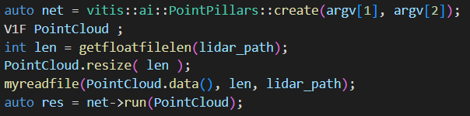
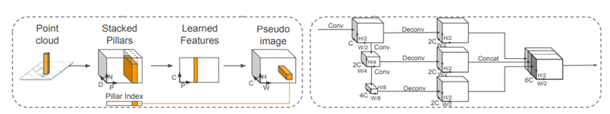
Vitis-AI: PointPillars Implementation
Vitis-AI is highly wrapped by API library
Pseudo code of Vitis-AI PointPillars model
Create nets for PointPillars
Including PointNet and Region Proposal Network (RPN)
Read point cloud data
Run the inference of the net

Slide 17
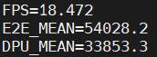
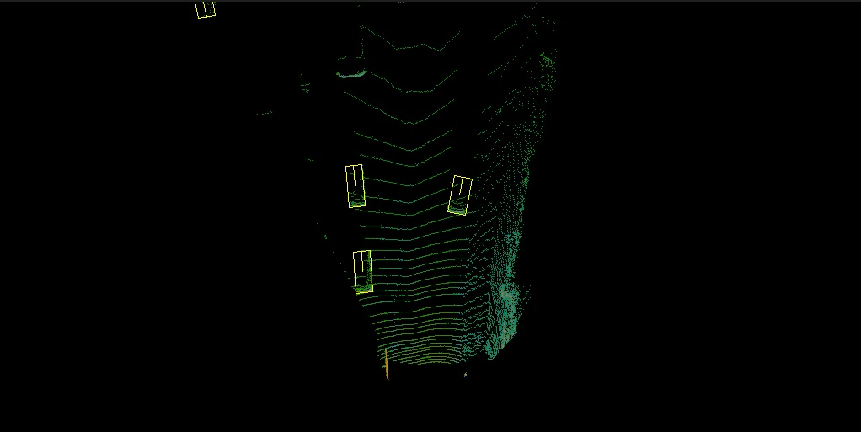
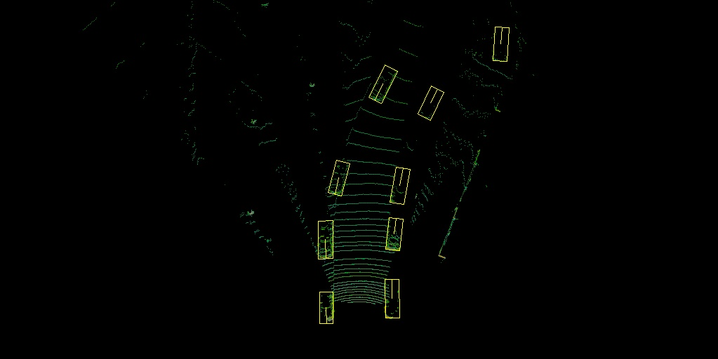
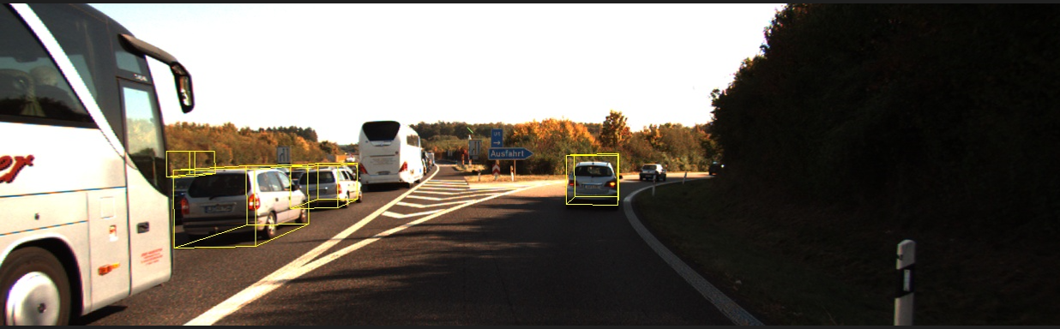
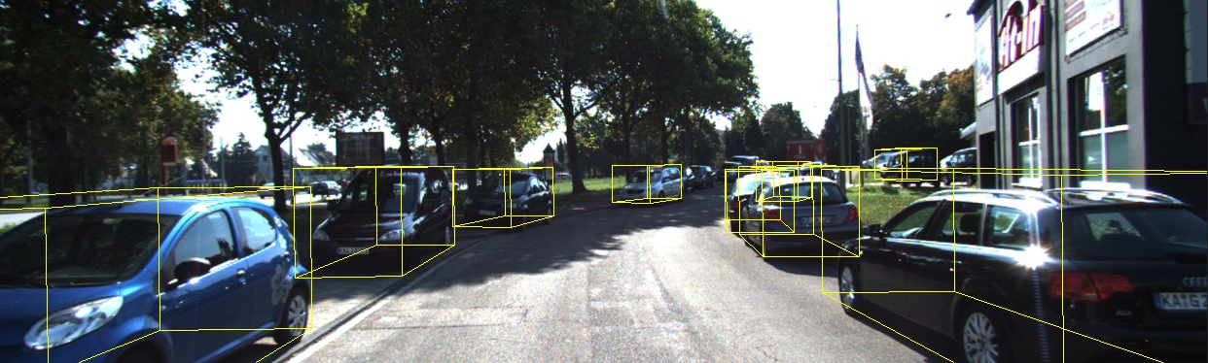
Vitis-AI: PointPillars Results (1/2)
Average inference time in Vitis-AI: 18.472 FPS
End-to-end time: 54.028ms
DPU execution time: 33.853ms

Slide 18
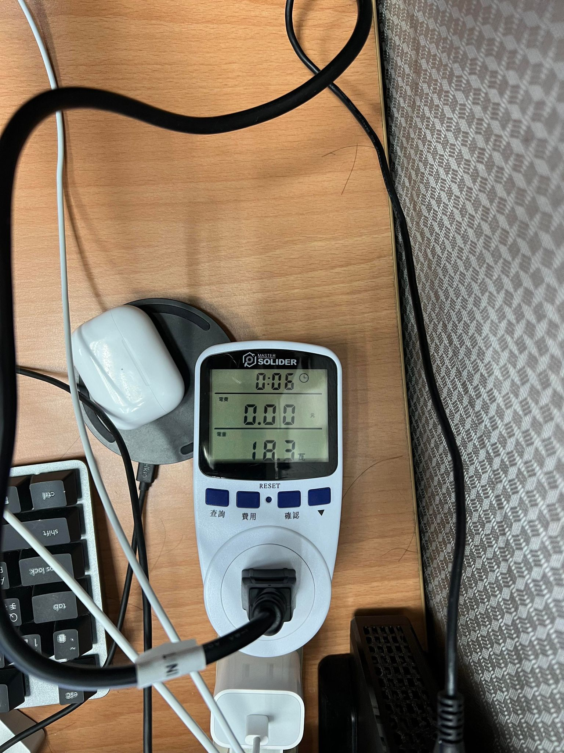
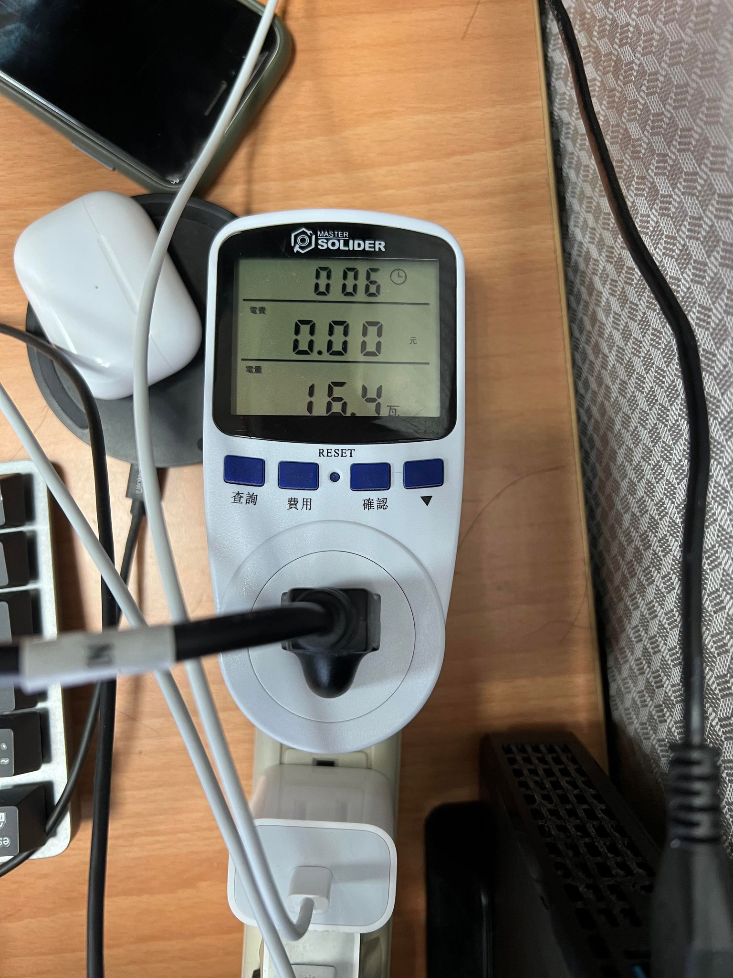
Vitis-AI: PointPillars Results (2/2)
Power consumption
-
= 1.9w

Slide 19
Executing with FINN

Slide 20
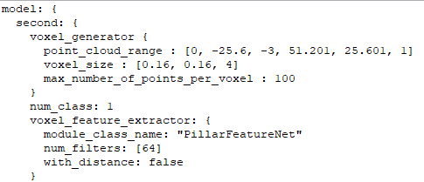
FINN: PointPillars Overview
Execution flow of FINN
Only backbone and SSD are accelerated on PL
HW: pp.xclbin, model: pipline.config
Github link:https://github.com/vision-agh/pp-finn

Slide 21
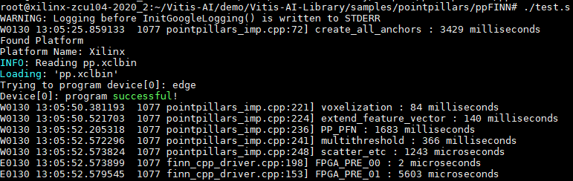
FINN: PointPillars Results (1/2)
We discover that the FINN version is modified from Vitis AI repo
The environment and the makefiles are too complicated
Reproduce results
Run time comparison (vs. paper)
Voxelization: 7.13m → 84m (14x)
Extend feature vector: 1.65m → 140m (84x)
PFN: 62.43m → 1683m (26x)
scatter: 0.72m → 1.24m (1.7x)
Pre: 3.1m → 5.6m (1.8x)

Slide 22
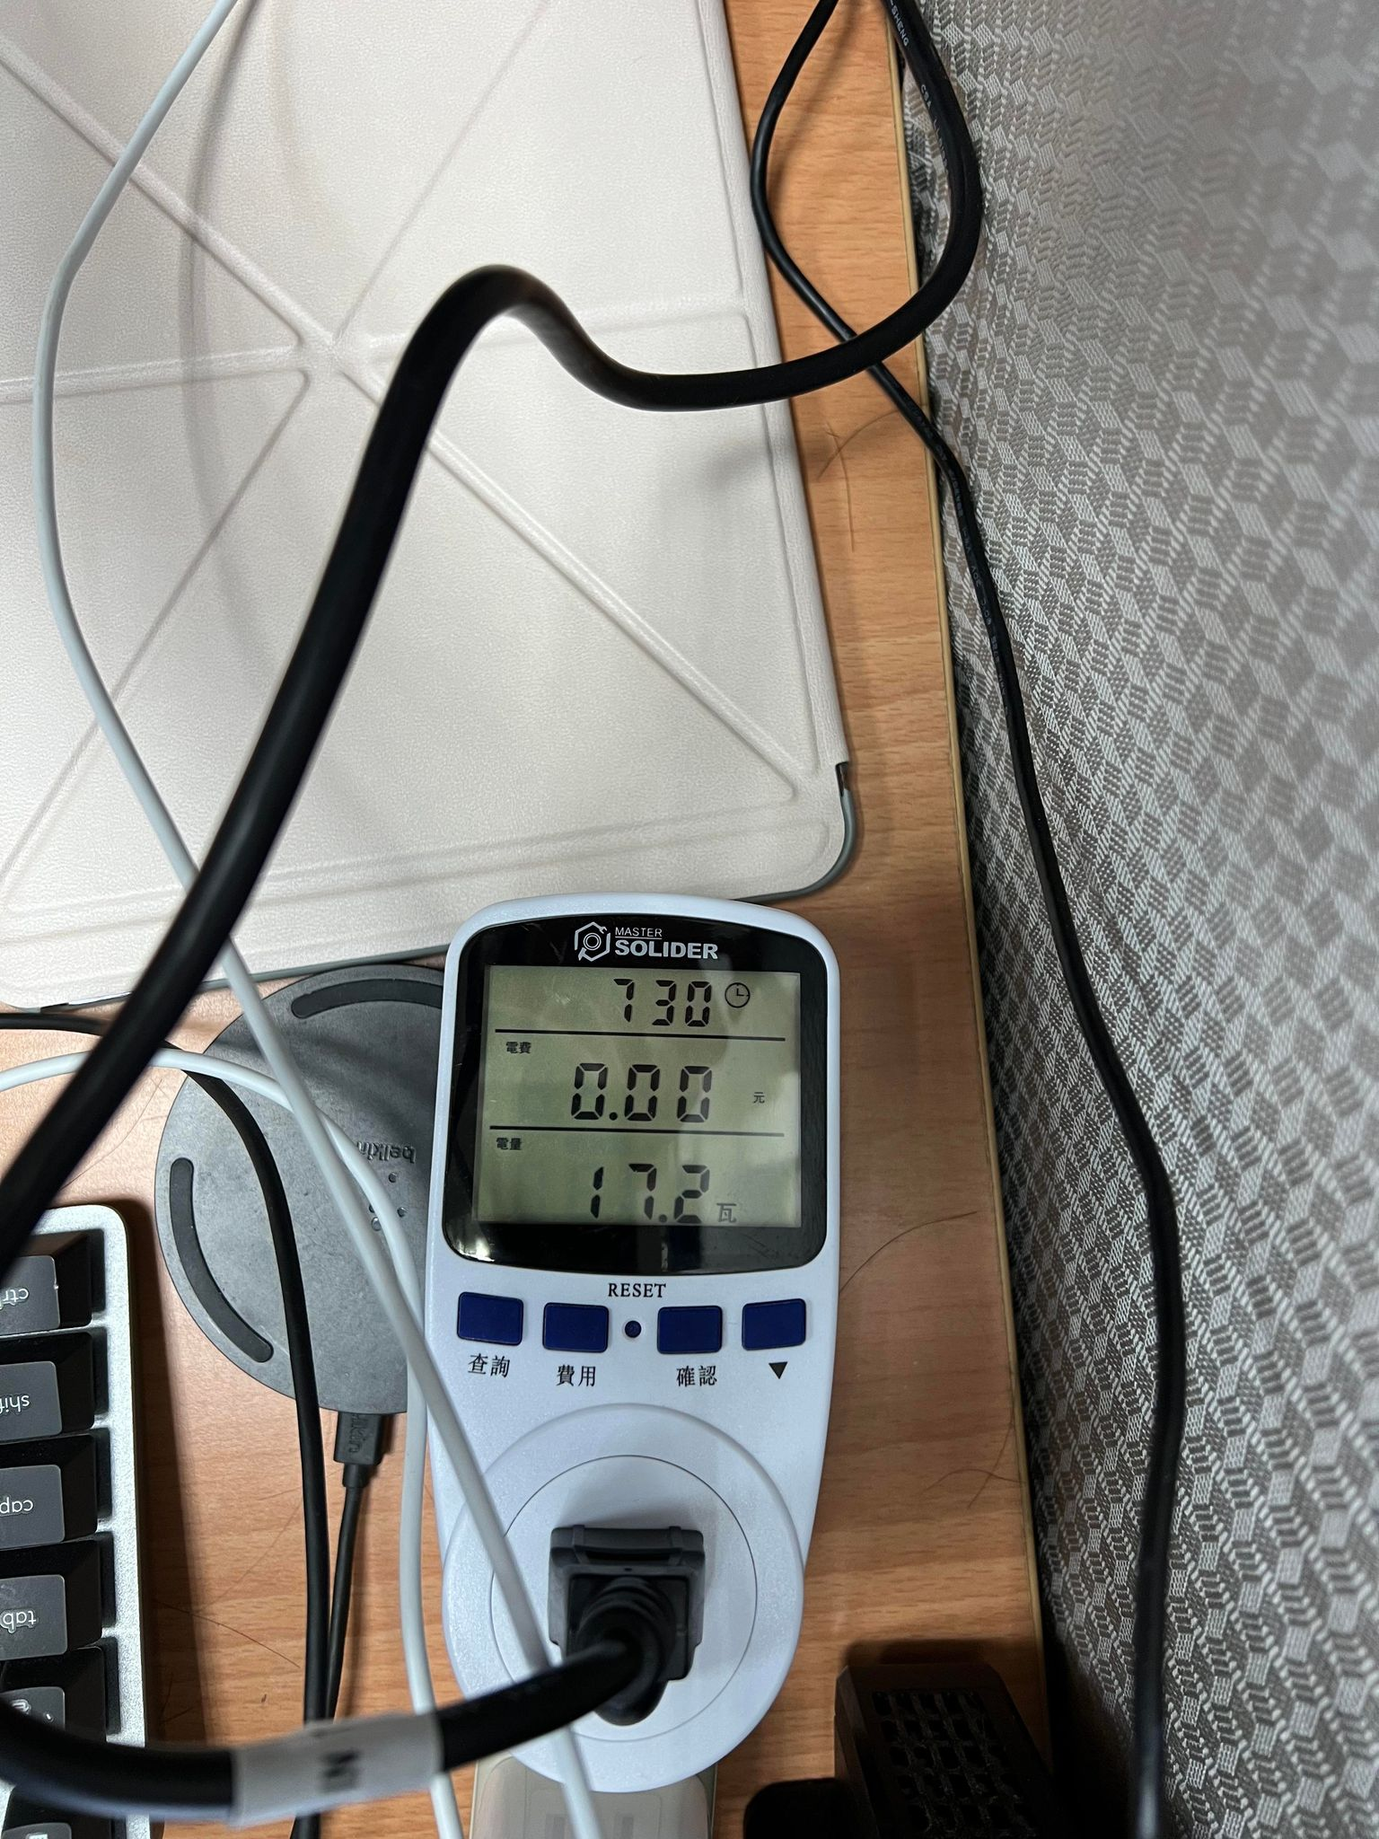
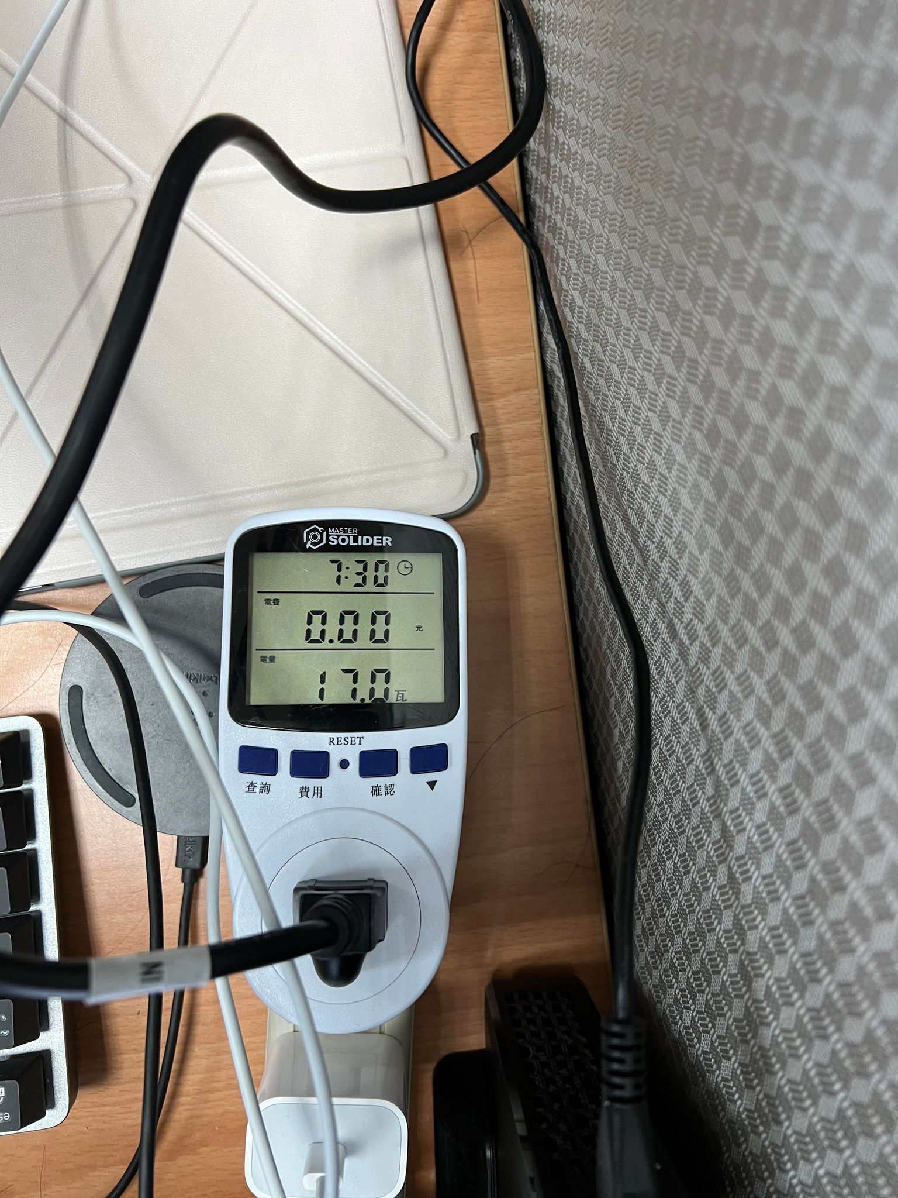
FINN: PointPillars Results (2/2)
Power consumption estimation
-
= 0.2w

Slide 23
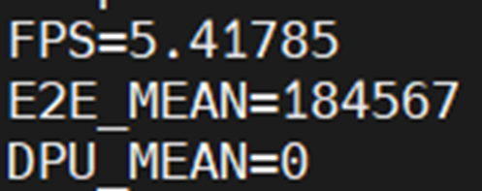
Model Transplant
As reported in the paper, the FPS is 2.67
The modified backbone may be the root cause
The modified backbone is transplant to the Vitis AI to evaluate its FPS
Vitis AI reported 5.41 FPS
Almost 4x slower
We can conclude that the modification of the original model for the FINN has large impact on FPS

Slide 24
Comparison

Slide 25
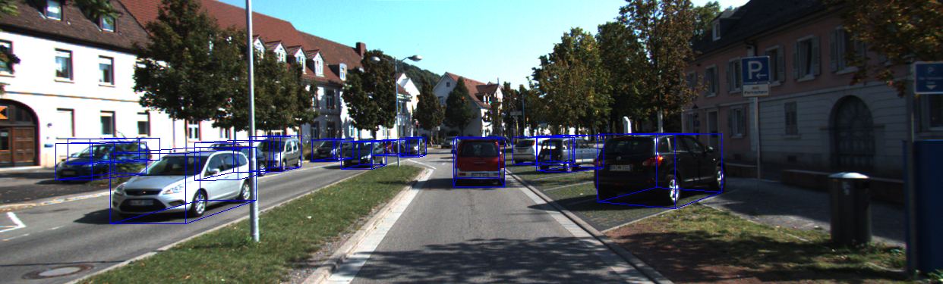
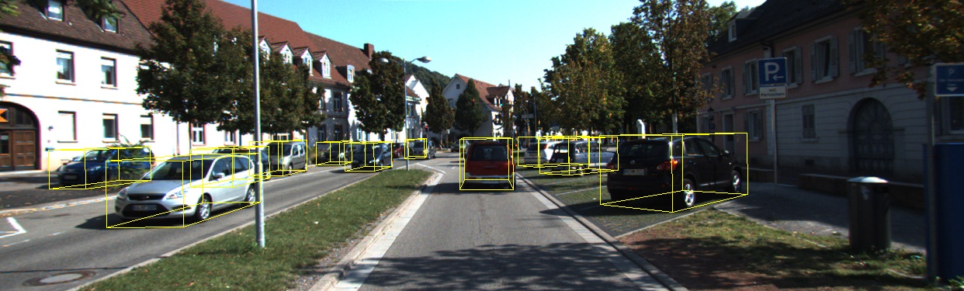
Visualization Analysis (1/3)
GPU
Vitis AI
Vitis AI and GPU end up with similar results

Slide 26
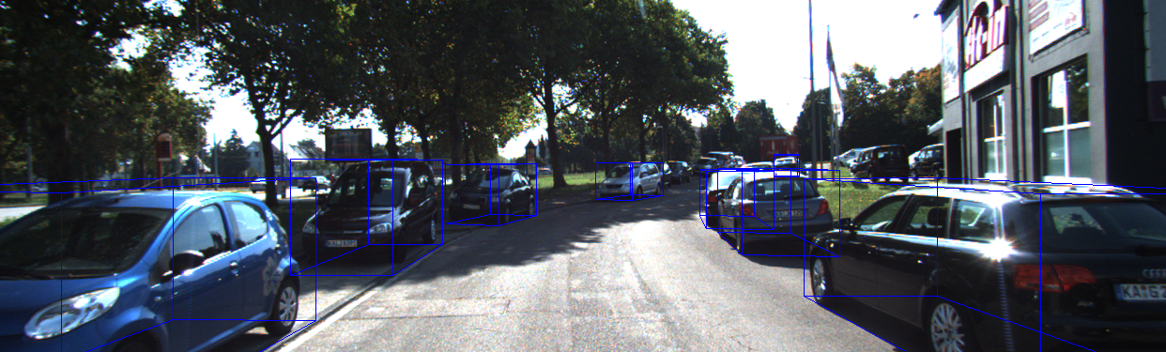

Visualization Analysis (2/3)
GPU
Vitis AI
Vitis AI and GPU end up with similar results

Slide 27
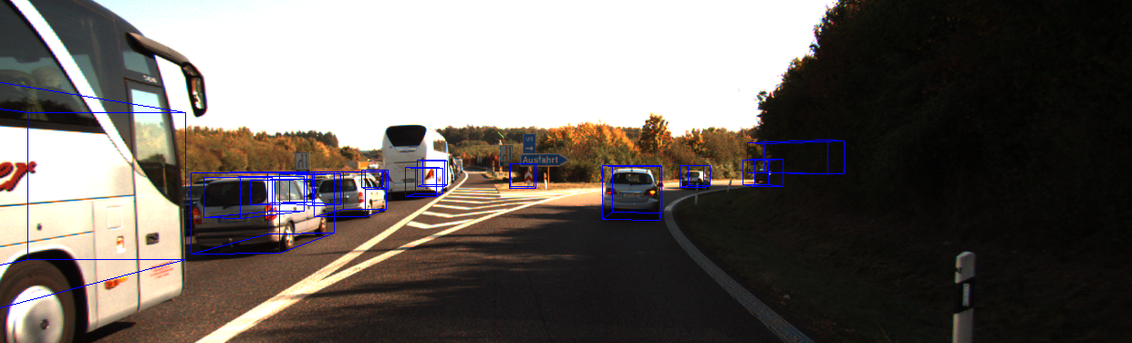
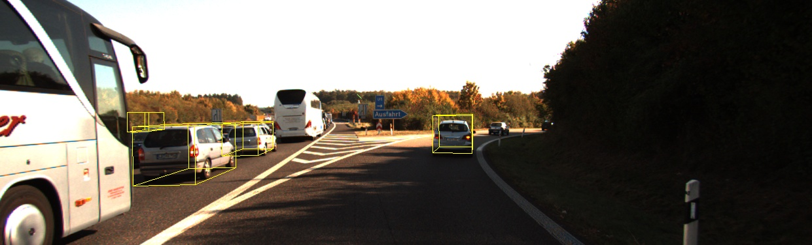
Visualization Analysis (3/3)
GPU
Vitis AI
Vitis AI lose information in some cases

Slide 28
Comparison Table
 | GPU | Vitis AI | FINN
Device | RTX A5000 | ZCU104 | ZCU104
FPS | 54.45 | 18.472 | 2.67
Power (watt) | 171 | 1.9 | 0.2
Frame per Joule | 0.32 | 9.722 (30x) | 13.35 (41.74x)

Slide 29
Conclusion
FPGAs still shows superior energy efficiency compared with GPUs
Develop with both Vitis AI and FINN is much difficult than PyTorch/CUDA
Vitis AI
Easier to deploy
No space to finetune
Only for application development
FINN
Requires several tools to generate the final executable files
Trade-off: model complexity vs. model compatibility
Generalizability vs. efficiency
Hard to debug → segmentation fault …
Compatibility between different versions
Difficult to setup the environment

Slide 30
Reference
[1] Geiger, A., Lenz, P., Stiller, C., & Urtasun, R. (2013). Vision meets robotics: The KITTI dataset. International Journal of Robotics Research (IJRR).
[2] Lang, Alex H., et al. "Pointpillars: Fast encoders for object detection from point clouds." Proceedings of the IEEE/CVF conference on computer vision and pattern recognition. 2019.

